Slide 1
Evaluating Fast and Efficient Methods for Retrieving Distance Information in the Internet
Instructors:
Dr. Danny Raz
Presentation by,
S.Karthik

Slide 2
Methods
We survey 5 different methods for the purpose of deducing the distance to a remote internet host.
The methods aim to improve the time and packet waste of the classical traceroute algorithm.
Some do not extract as much information as the classical method.

Slide 3
Classical Traceroute
Local host sends a UDP datagram with TTL = 1 to the destination host.
The first router decreases TTL to 0 and sends back an ICMP “time exceeded” message.
Local host sends a datagram with TTL = 2 to the destination host.
The first router decreases TTL to 1, the second router decreases TTL to 0 and sends back an ICMP “time exceeded” message.

Slide 4
When reaching a certain TTL, the datagram reaches the destination.
Output: hop distance, RTT, route.

Slide 5
All datagrams are sent to a port with an unlikely value, therefore, when the destination receives that datagram it rejects it and sends back an ICMP “destination unreachable” message with code field “port unreachable”.
In practice, we learnt that using destination port of 80 is, surprisingly, more useful!

Slide 6
Parallel Algorithm
Local host sends CHUNK_SIZE UDP datagrams simultaneously with increasing TTL’s
Each datagram carries a unique sequence number which helps to match a given response to its original datagram
Local host waits for CHUNK_SIZE responses

Slide 7
If the destination has not been reached next CHUNK_SIZE datagrams are sent
Output: hop distance, RTT, route

Slide 8
Binary Search
Instead of sending datagrams with sequentially increasing TTLs, finds the exact hop distance using binary search.
Output: hop distance, RTT.

Slide 9
Copied TTL
The response ICMP packet to an outgoing UDP packet includes the header of the latter.
This includes the final value of the TTL field.
For original TLL x and final (copied) value y, the hop distance is x-y.
Output: hop distance, RTT.

Slide 10
Response TTL
Each incoming packet carries its own TTL value, which is a function of the original value set and the incoming hop distance.
Most systems use specific initial values for TTL as 255, 127 and 31.
For “guessed” initial value x and final value y, the hop distance estimation is x-y.
Output: incoming hop distance, RTT.

Slide 11
Implementation
Each method is implemented by a corresponding function that fills the structure
typedef struct _RouteInfo {
int rtt; // round-trip time
int hopdist; // hop distance
int time_waste_on_test; // time wasted on testing this route
int cnt_packet_waste; // packets wasted on testing this route
int resp_ttl; // ttl value of response (incoming) packet
char path[MAX_PATH_STR_LEN]; // coma-separated path
} RouteInfo;
as well as it can.

Slide 12
Implemetation: udping
Essential function in the classical and bin search methods. Sends a UDP packet and waits for the ICMP response it triggers.
Returns –1 if the TTL of the original packet was too low, and 1 if it was exact or too high.

Slide 13
Impl: Unlikely Destination Port?
We noticed that arbitrary values for the destination port field in outgoing UDP packets causes them to be silently dropped by firewalls.
When the port number is set to 80, they pass!
The destination does not know what to do with the combination UDP+port 80.
It responds with ICMP “Dest Unreachable”.
Thus, the desired effect is obtained.
This phenomenon has disappeared during the last few days.

Slide 14
Impl: WinPCap
This is a port of the packet-capture library, based on the Berkeley packet filter, to the Win32 operating systems.
We use it to sniff packets that belong to established TCP sockets.
We are interested in the TTL of packets arriving from remote Web servers. (response TTL)
Since the 3-way handshake is enough, the socket is connected and immediately closed.

Slide 15
Impl: WinPCap timeout
We would have liked to wait up to timeout seconds for a single packet (whichever occurs first).
Unfortunately, one cannot request this from pcap – you may set a timeout, but it will not stop sniffing after finding one packet.
The solution for this waste of time was to set a short timeout and repeat it many times until the first packet arrives.

Slide 16
Conclusions – Binary, Parallel
The binary search method is good only as an anecdote. The copied TTL method is quicker, as exact, and less prone to errors.
If we are interested in the full path, we have to choose between the classic algorithm and the parallel one. We found that the parallel algorithm is 3 times faster – the median speed ratio is 2.8, while its overhead in terms of packet waste is only 2. In %11 of the cases, the parallel method was slower.
Surprisingly, in %10 of the cases, the packet waste of the parallel method was lower than that of the classical.

Slide 17
Conclusions – ResponseTTL
When looking at the methods which do not give us the full path, Copied TTL algorithm is 1.3 times faster than Response TTL, and requires only one packet. (the binary algorithm is much slower and inefficient than the two of them).
Moreover, Response TTL is the least accurate method: the hop distance it measured differs by 0.5±3 from the distance measured in the classical algorithm. For the other methods the difference is below ±0.2.
However, this is the most successful method – supported by most hosts.

Slide 18
Conclusions – ResponseTTL
The Round-Trip-Time measured by ResponseTTL is longer than that measured by Classical method in %90 of the cases.
We think that this is because TCP packets have a different and slower routing comparing to ICMP packets.

Slide 19
Cost of Path Information
We compared the time wasted during the Parallel method to that during CopiedTTL method, and found that it was much longer – 5 times longer, with huge deviation.
Surprisingly, we did not find a correlation between this value and the length of the path.
In terms of packets, the cost is linear in the path length.

Slide 20
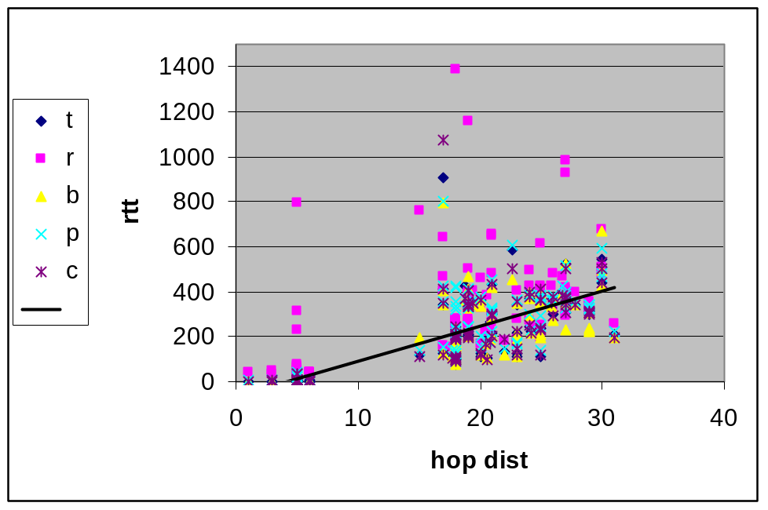
Hopdist/RTT Linearity?
Yes, but with large deviation – the hop distance does not reflect accurately the RTT.

Slide 21
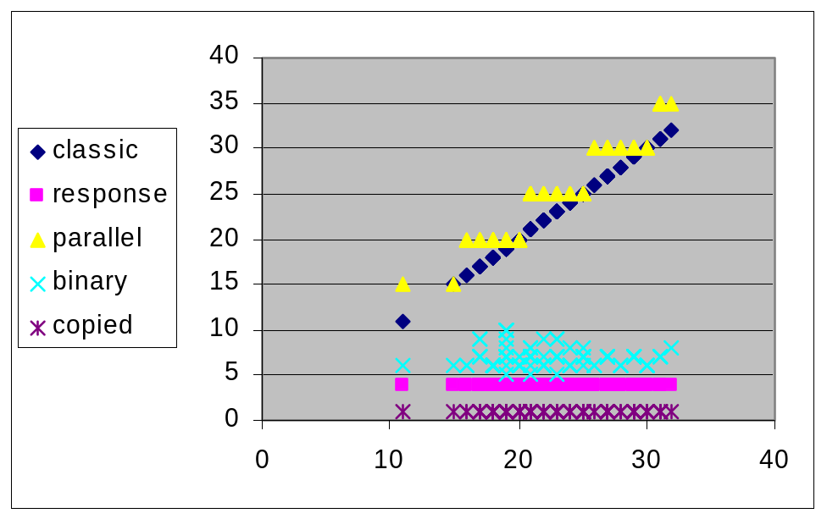
Packet Waste vs. Hopdist
This relation is much clearer:

Slide 22
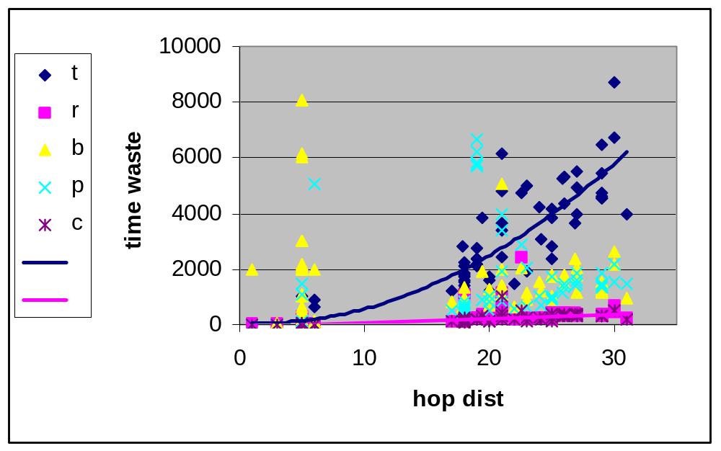
Time Waste vs. Hopdist
Classical seems parabolic, ResponseTTL and CopiedTTL seem linear, as expected.
Binary and Parallel do not show strong correlation.

Slide 23
Methods Dis/adventages
Classical
1. Reliable, Path info
2. Slow - quadratic time waste, Linear packet waste.
Parallel
1. Path info, Quicker than Classical.
2. Causes congestions, High packet waste.
Binary
1. Elegant idea, Logarithmic packet waste (almost constant in practice).
2. Unreliable – prone to errors, No full path info.

Slide 24
Methods Dis/adventages
CopiedTTL
1. Only 1 packet sent => low packet and time waste, Simple.
2. No path info
ResponseTTL
1. Works with all servers – does not require ICMP support, Measures incoming hop distance.
2. Relies on guessing the intial TTL, Implementation required SOCK_RAW support, RTT is longer (probably because of TCP usage)

